Slide 1

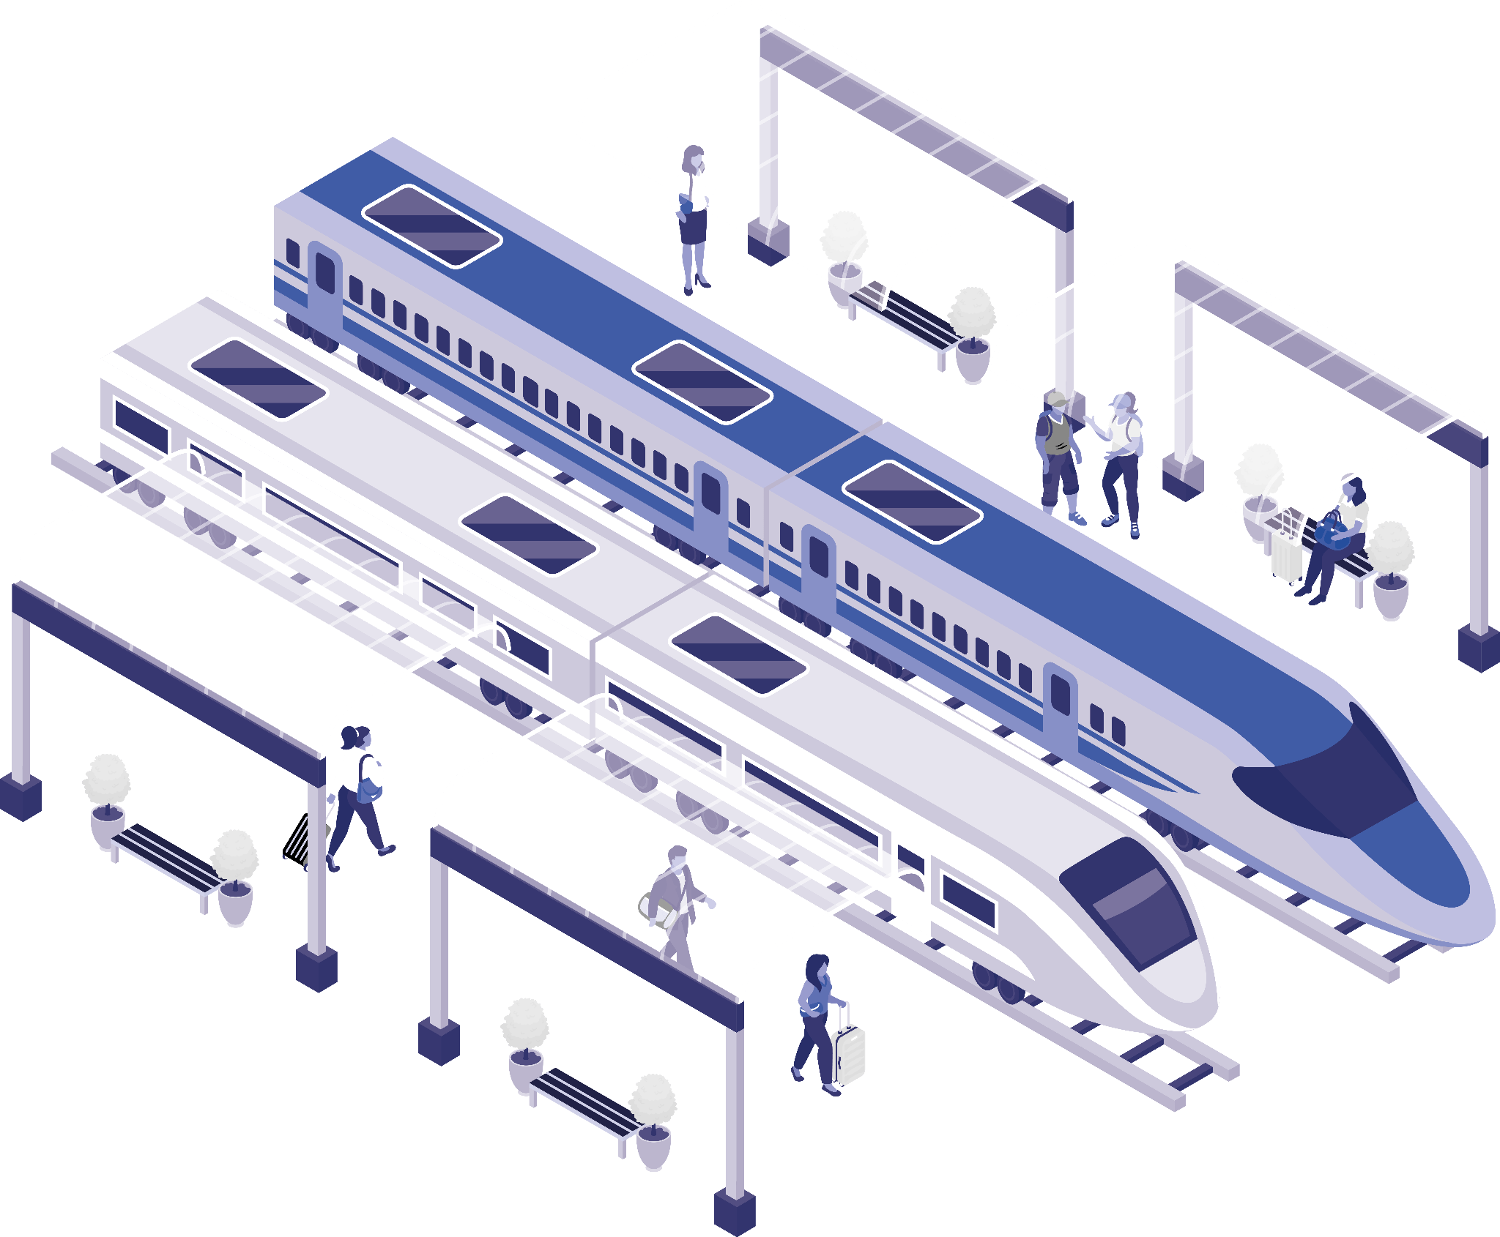
Railway Ticket Booking
NAME:

Slide 2
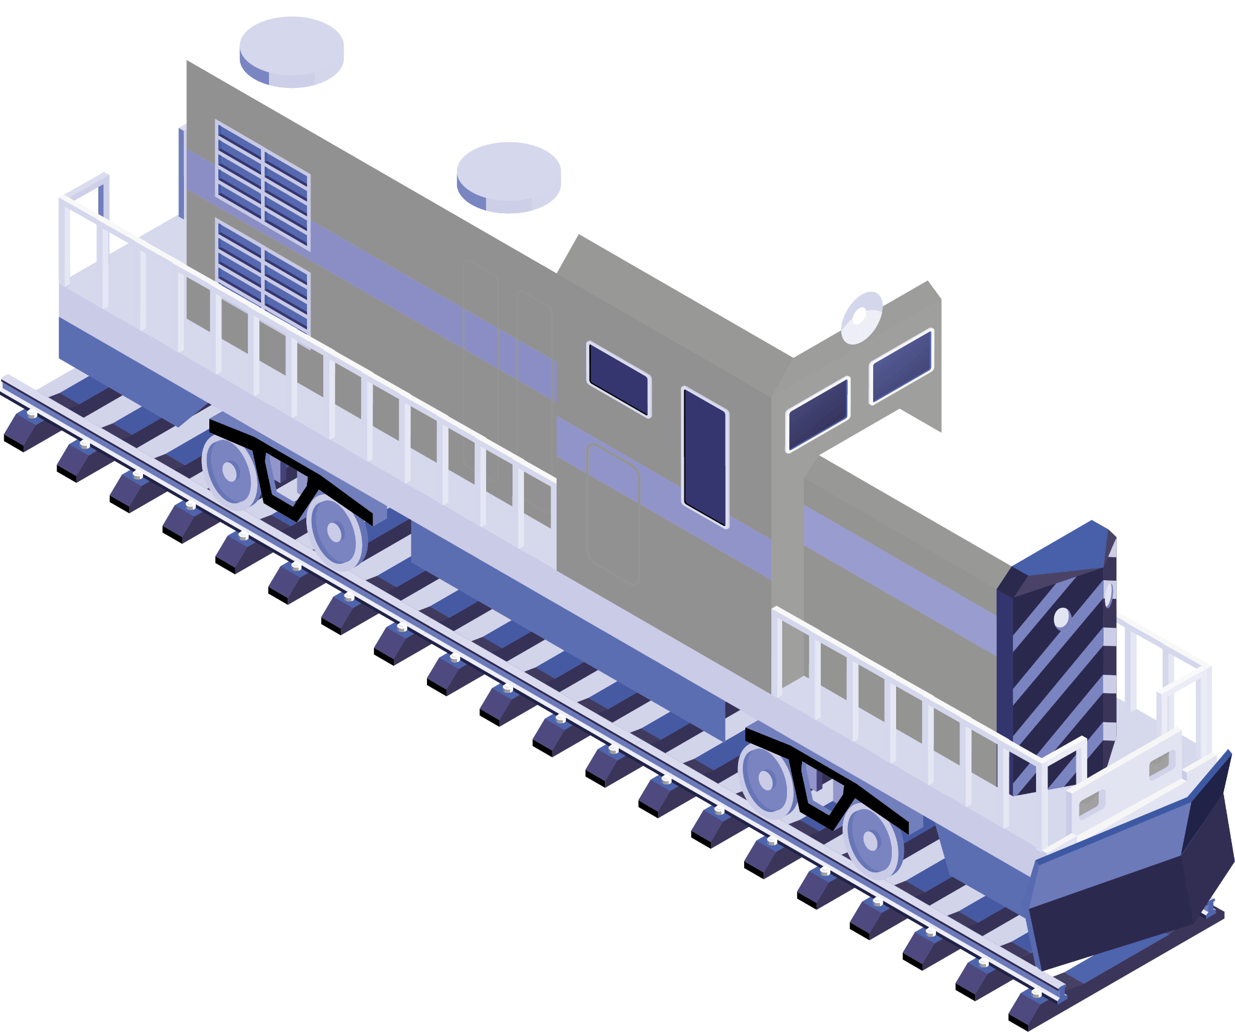
Introduction
Welcome to our presentation on Railway Ticket Booking, where we'll explore the transformation of the travel industry through digital ticketing solutions.
In an era of rapid technological advancements, the way we book train tickets has evolved significantly, providing travelers with greater convenience and efficiency.
we'll discover how online ticket booking and mobile applications have revolutionized the way we secure our seats on trains. We'll also explore the benefits of these innovations, providing travelers with flexibility, discounts, and time-saving options.

Slide 3

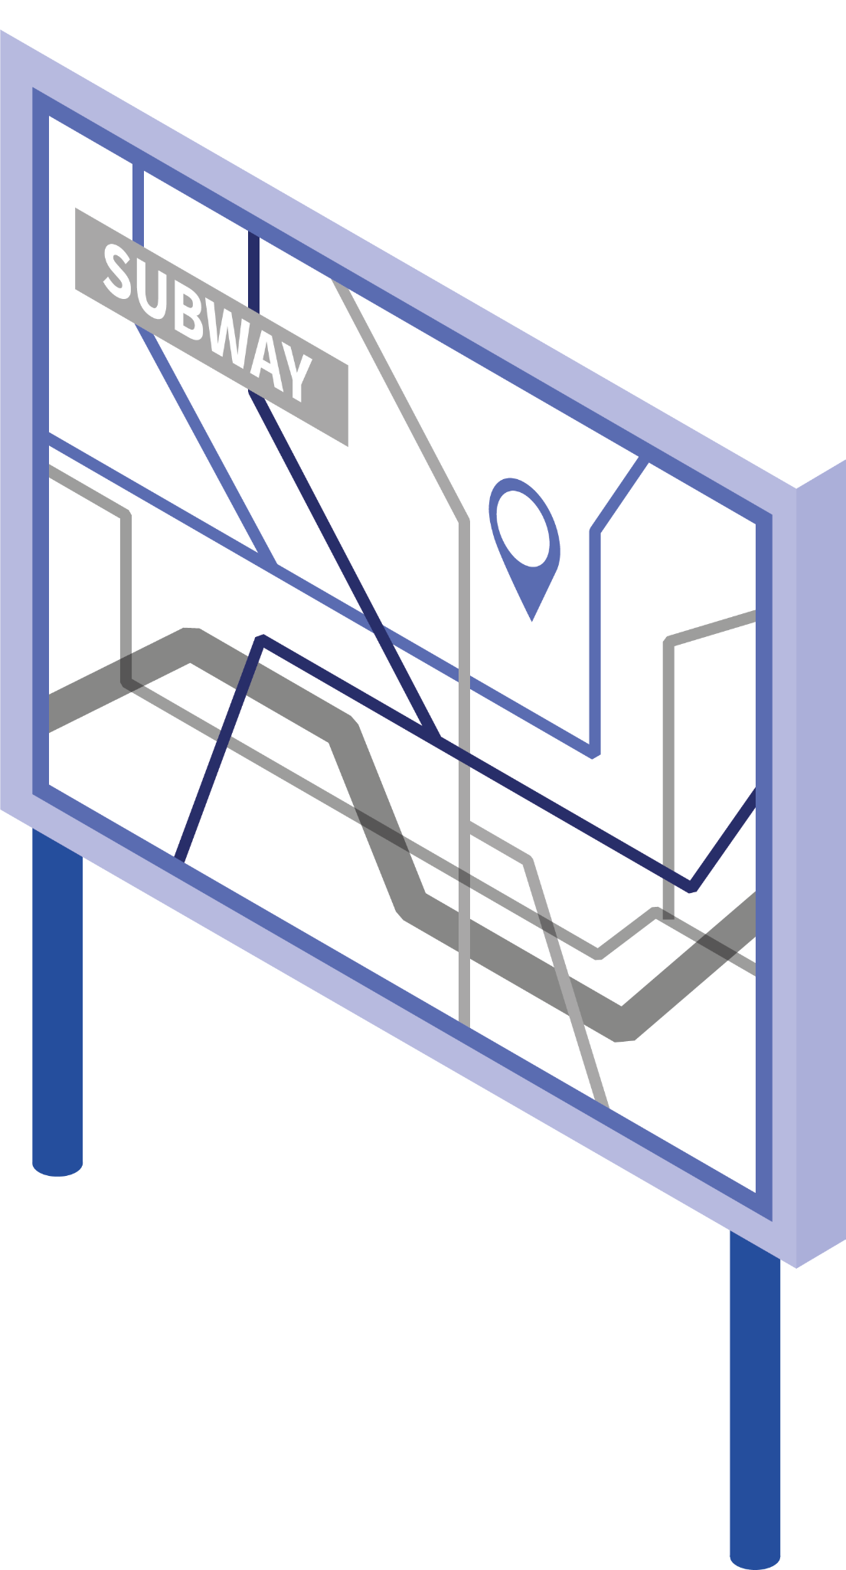
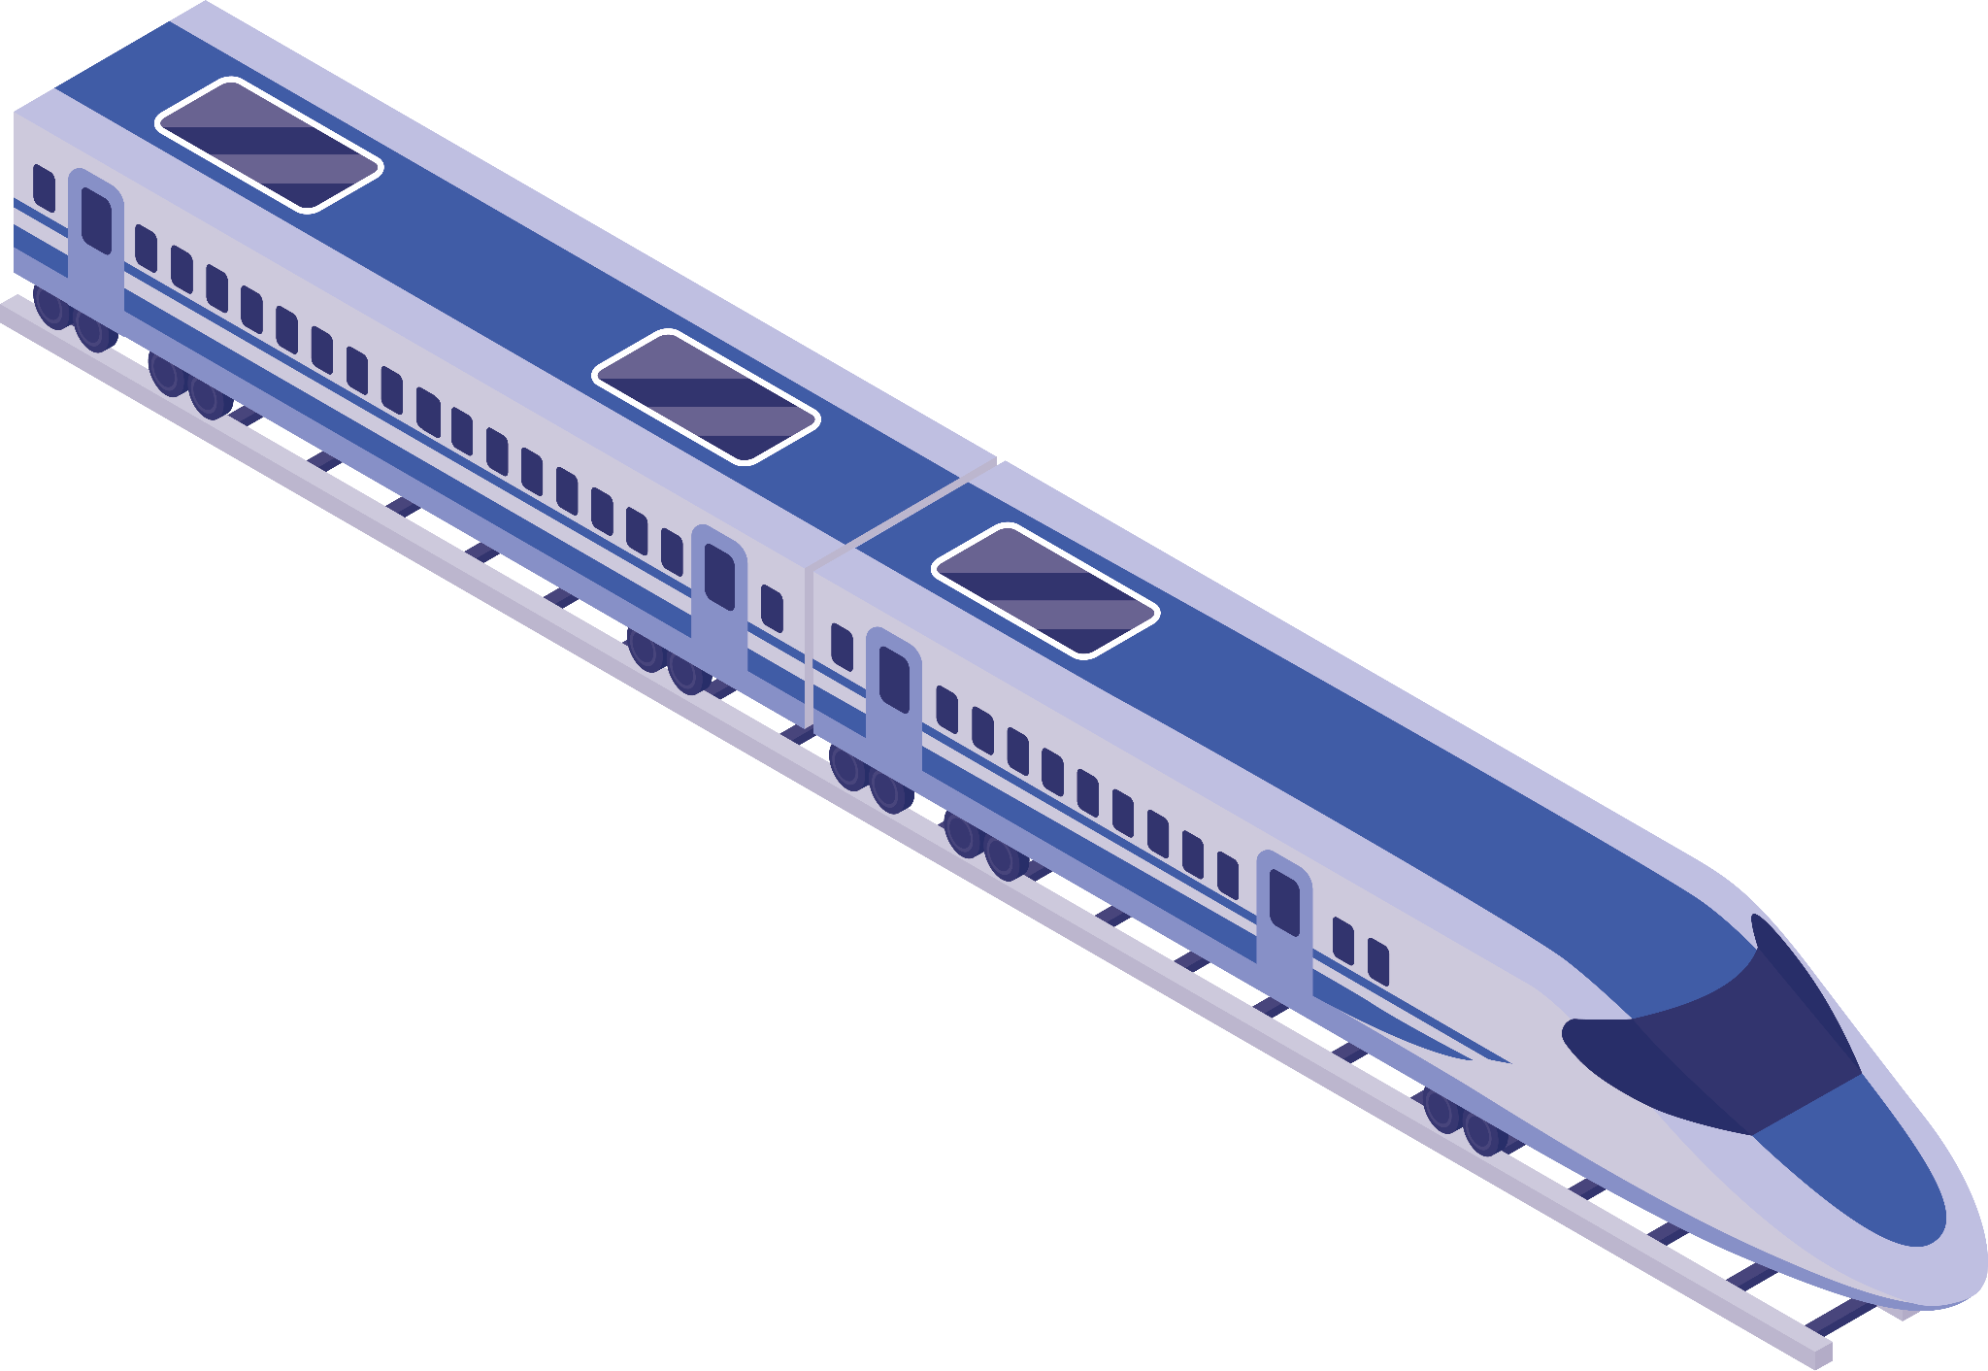
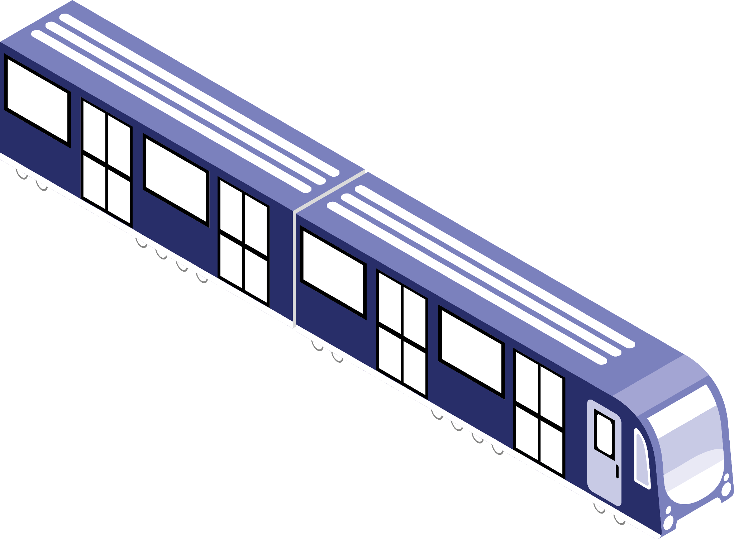
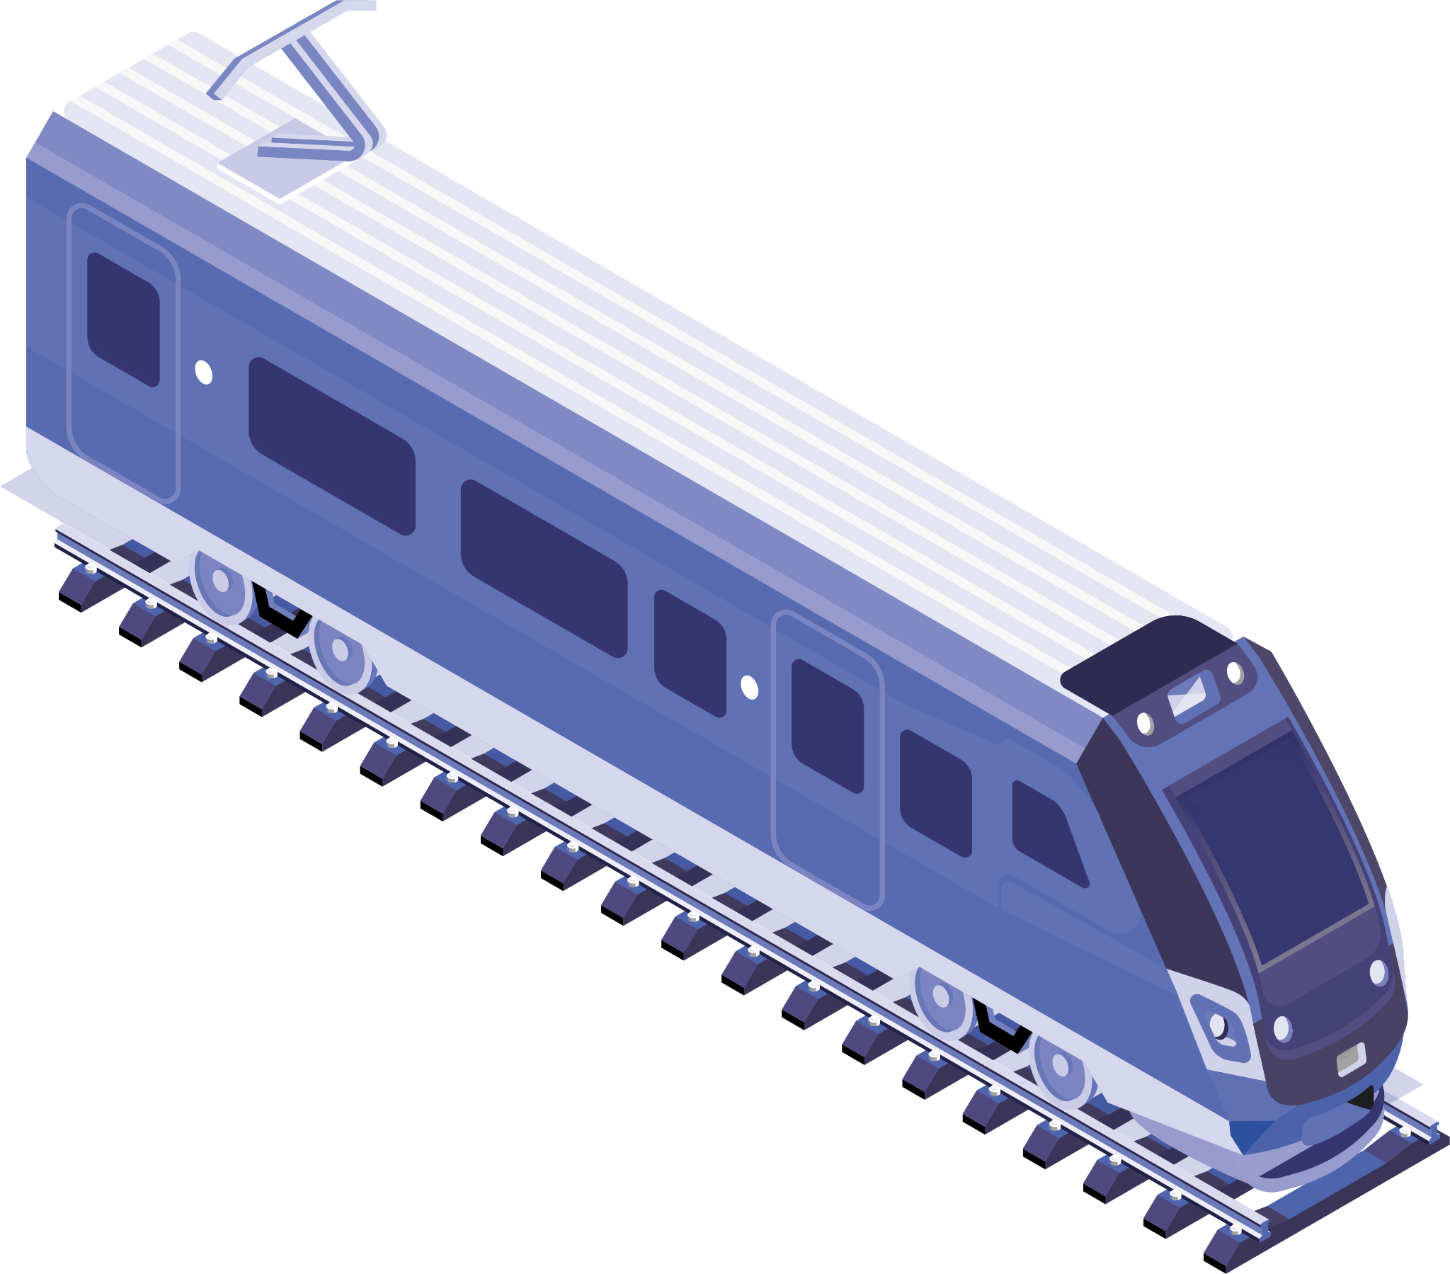
Concepts Use
2.iOFiles
3.
1.ArrayList
4.
6.
5.

Slide 4
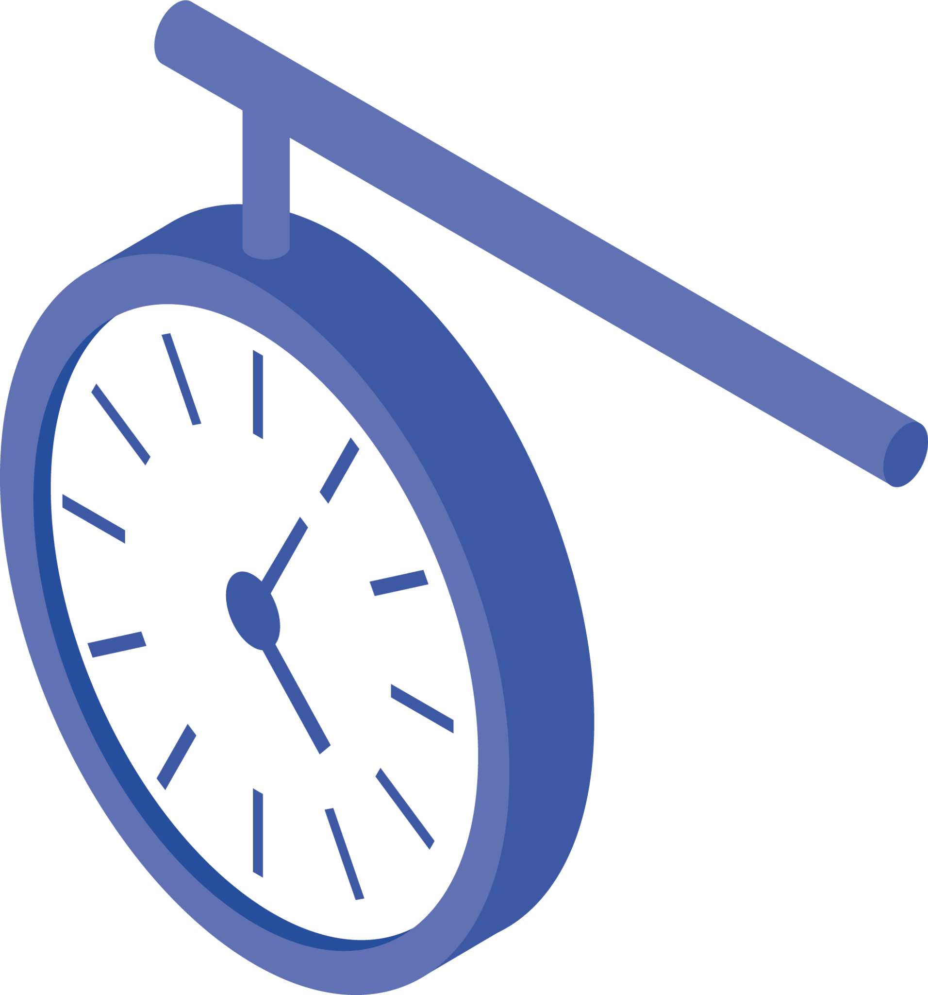
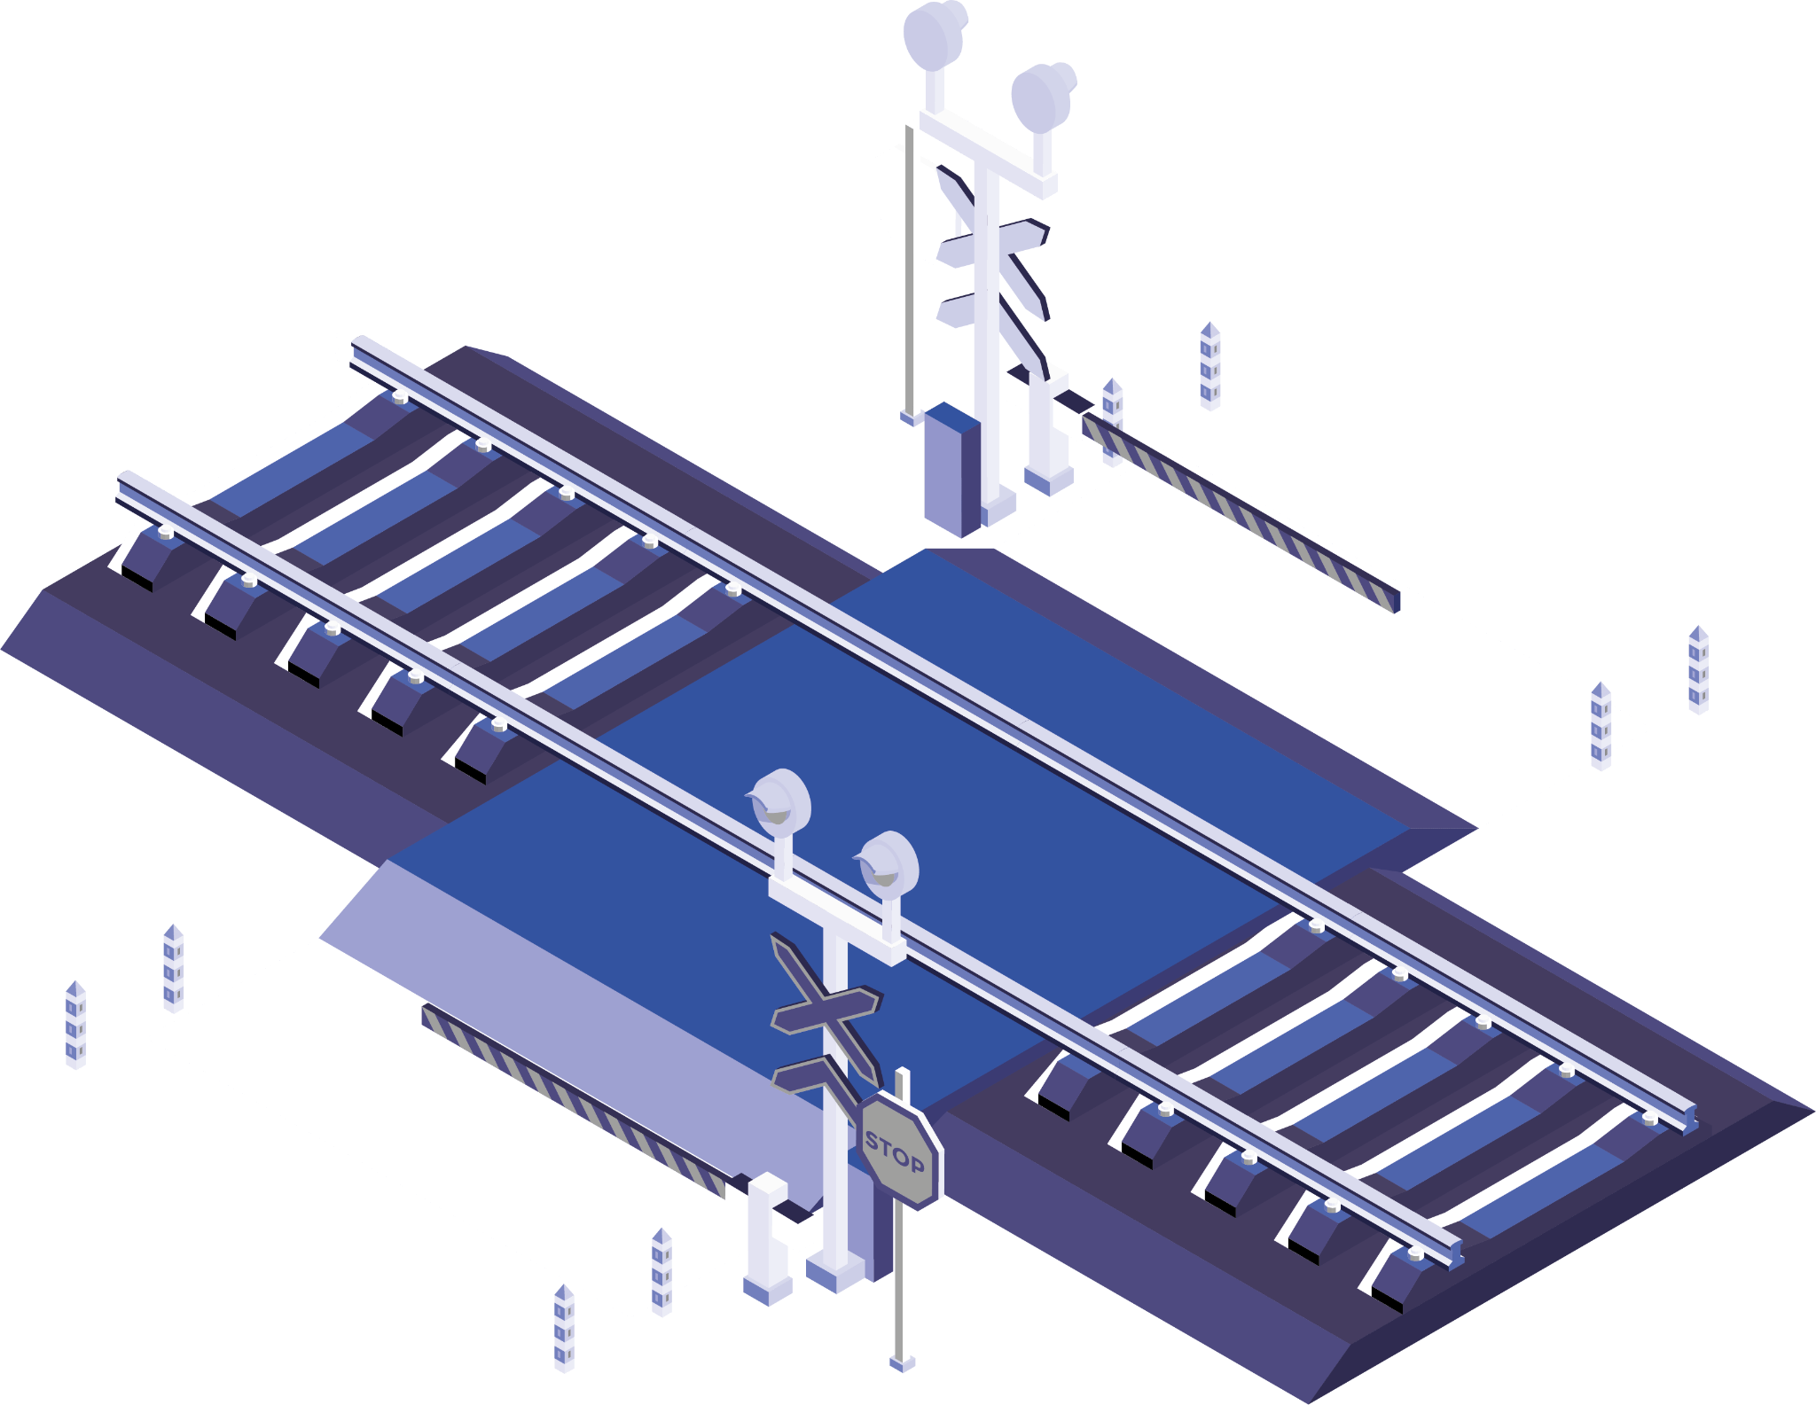
Interfaces
1
2
Admin
User

Slide 5
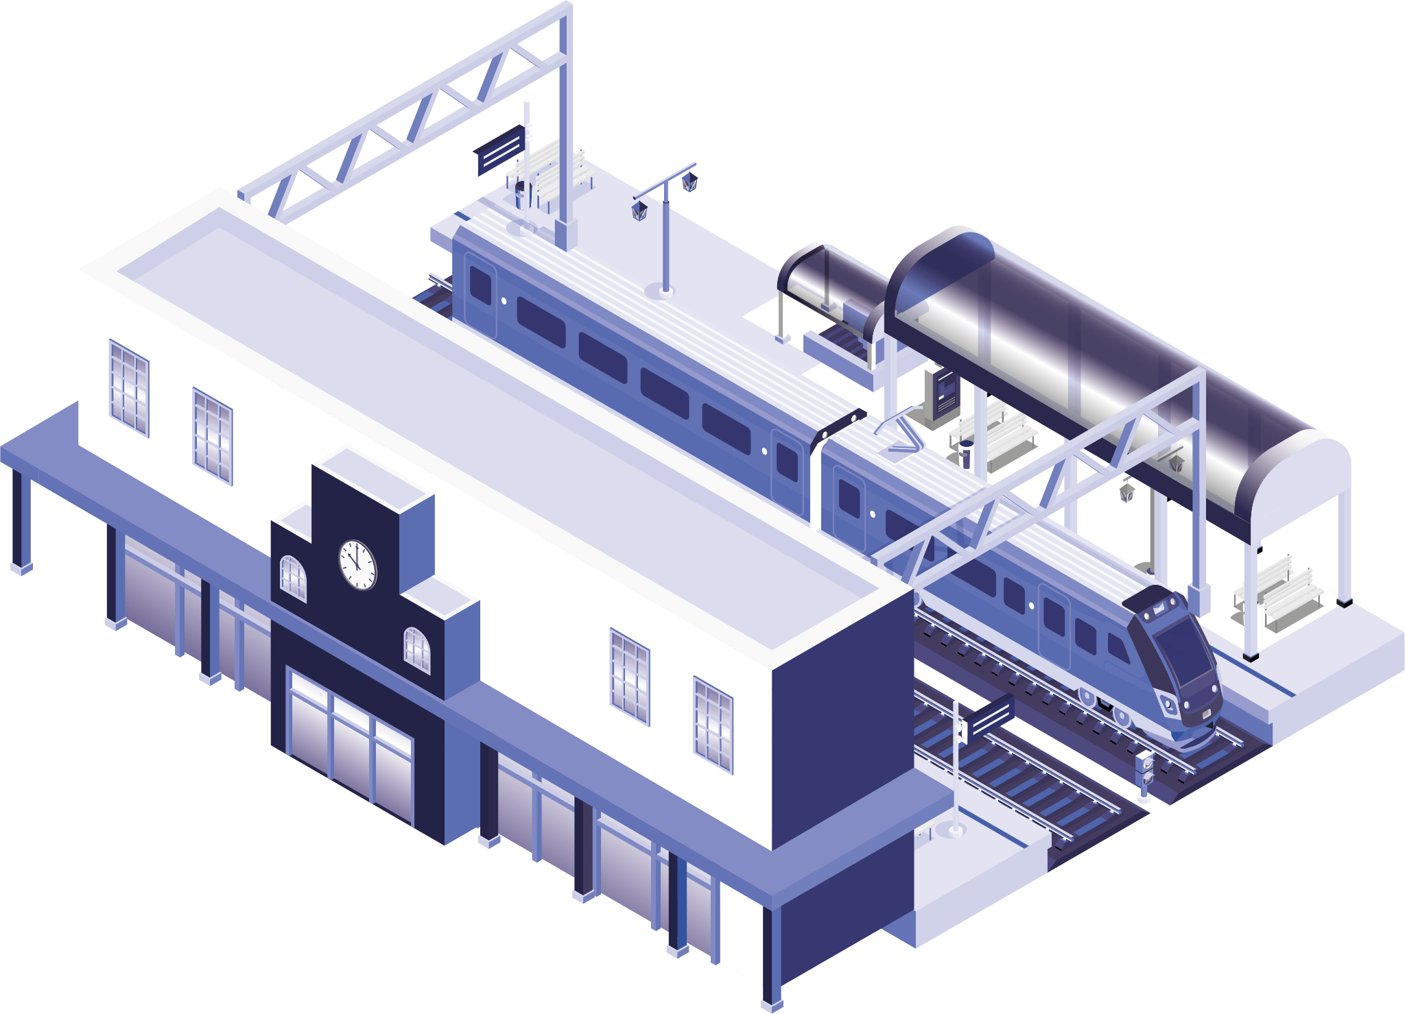
1
Admin
Methods:
1.Add Train
2.Add Route
“write : how is works?

Slide 6
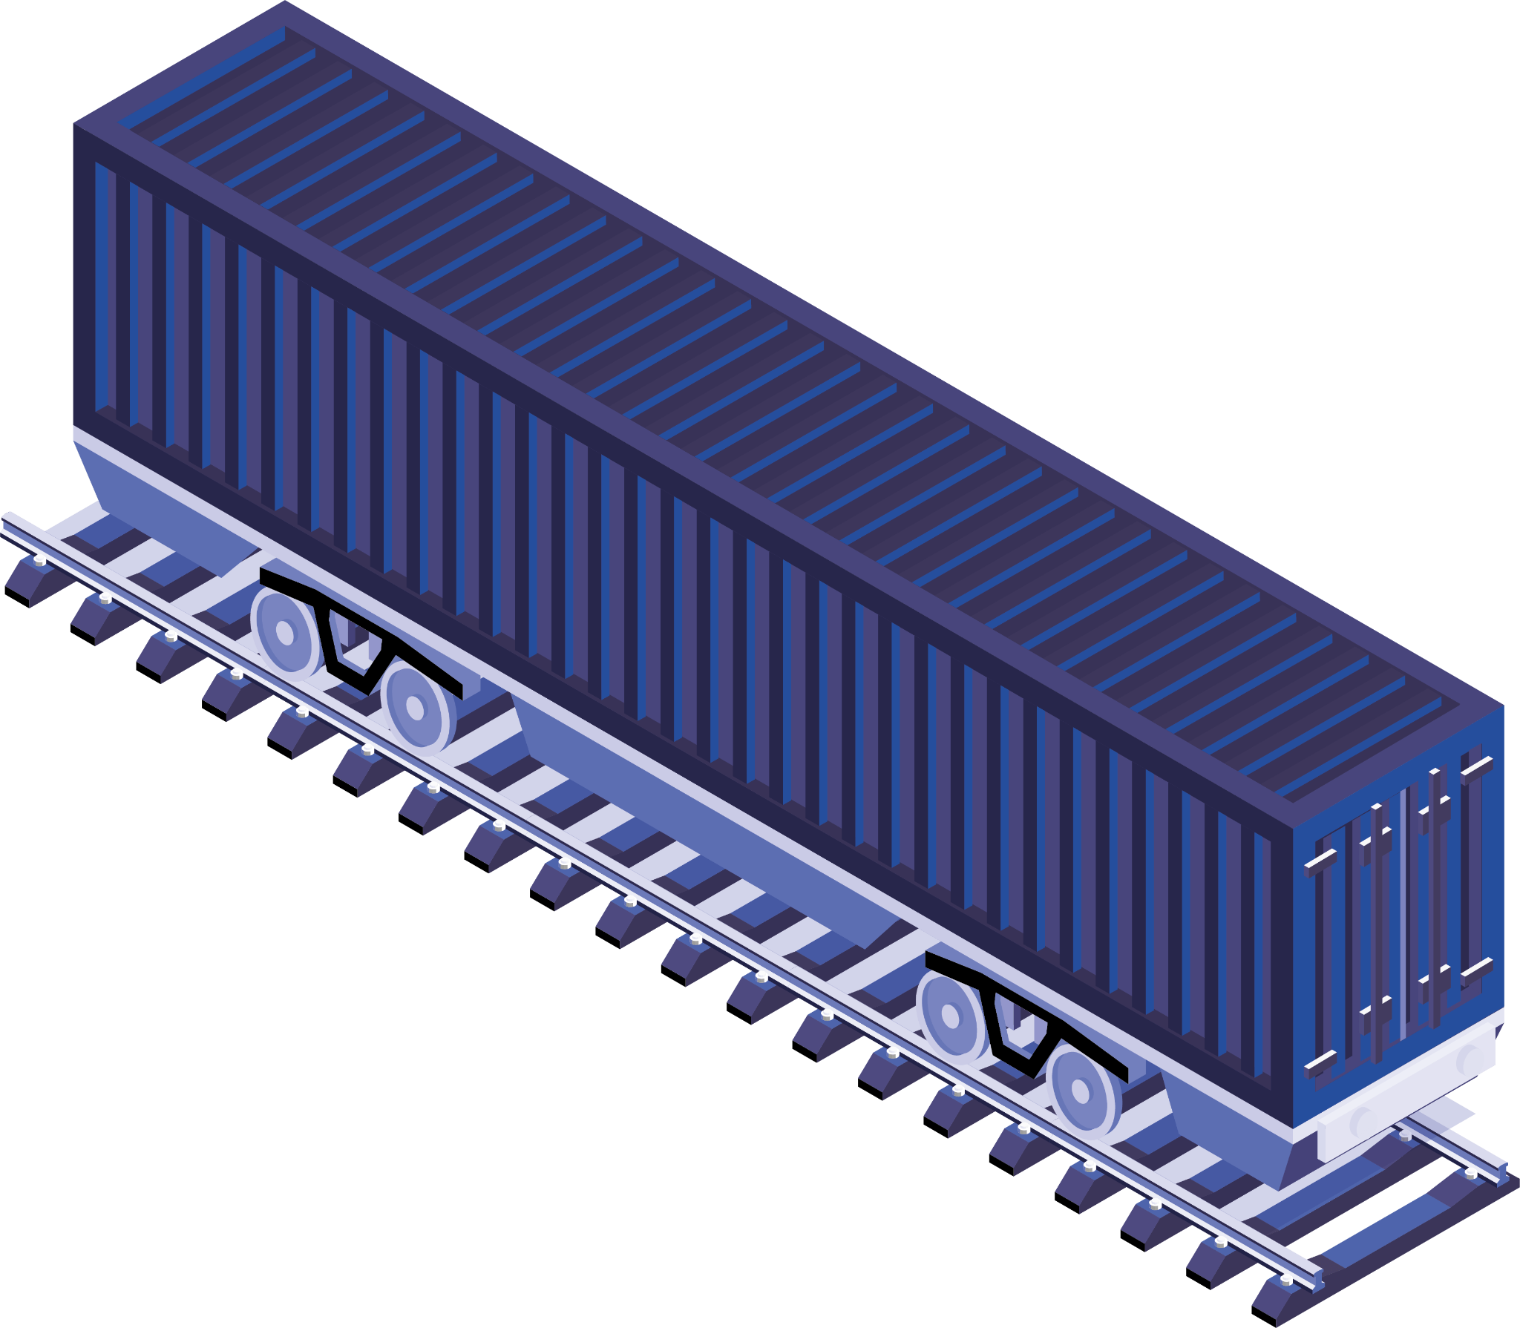
2
User
Methods:
1.TicketBook
2.ViewTicket
3.PrintTicket
“write : how is works?

Slide 7

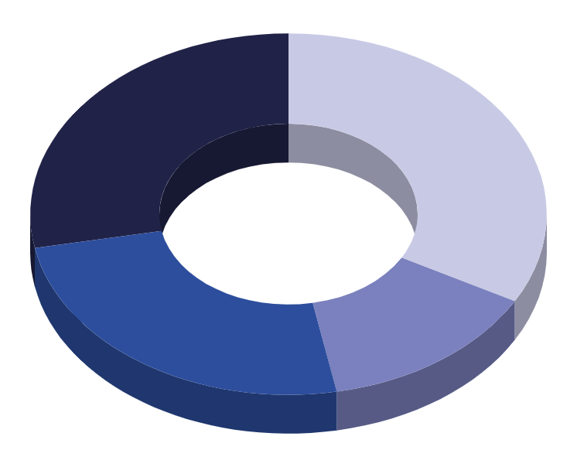
Diagram

Slide 8
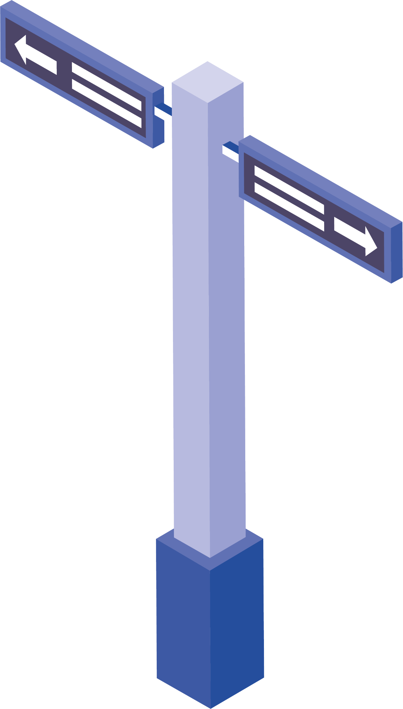

Benefits
Convenience
Time-saving
Access to Discounts and Offers
Reduced Dependency on Physical Ticket Counters
Paperless and Environmentally Friendly
Booking Flexibility
User-Friendly Interfaces

Slide 9
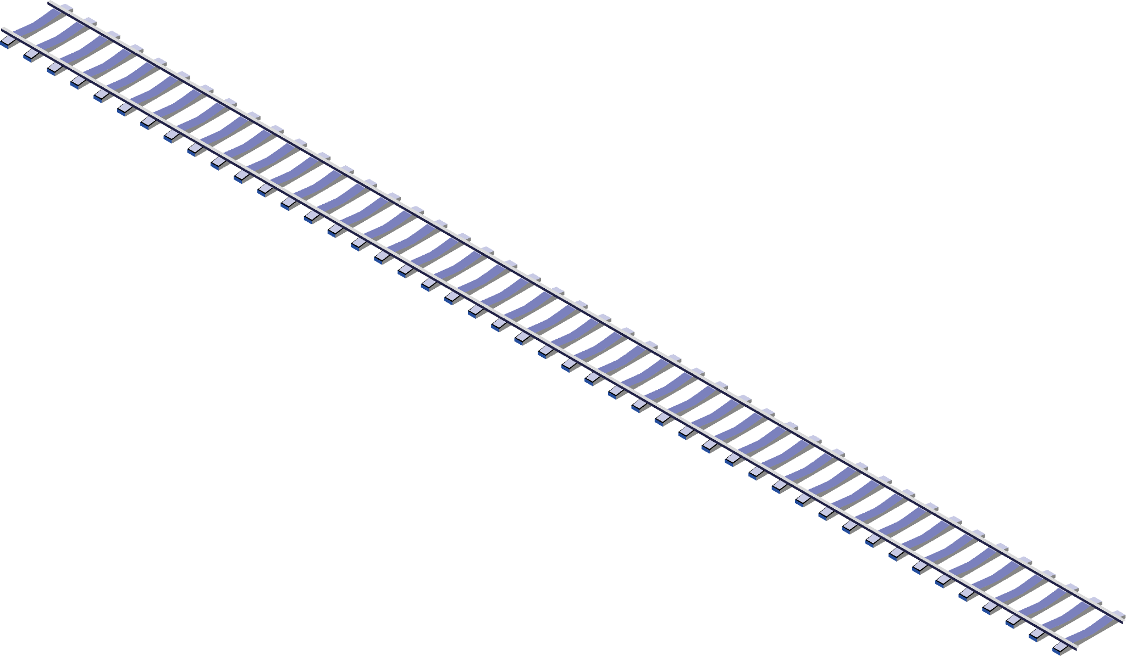
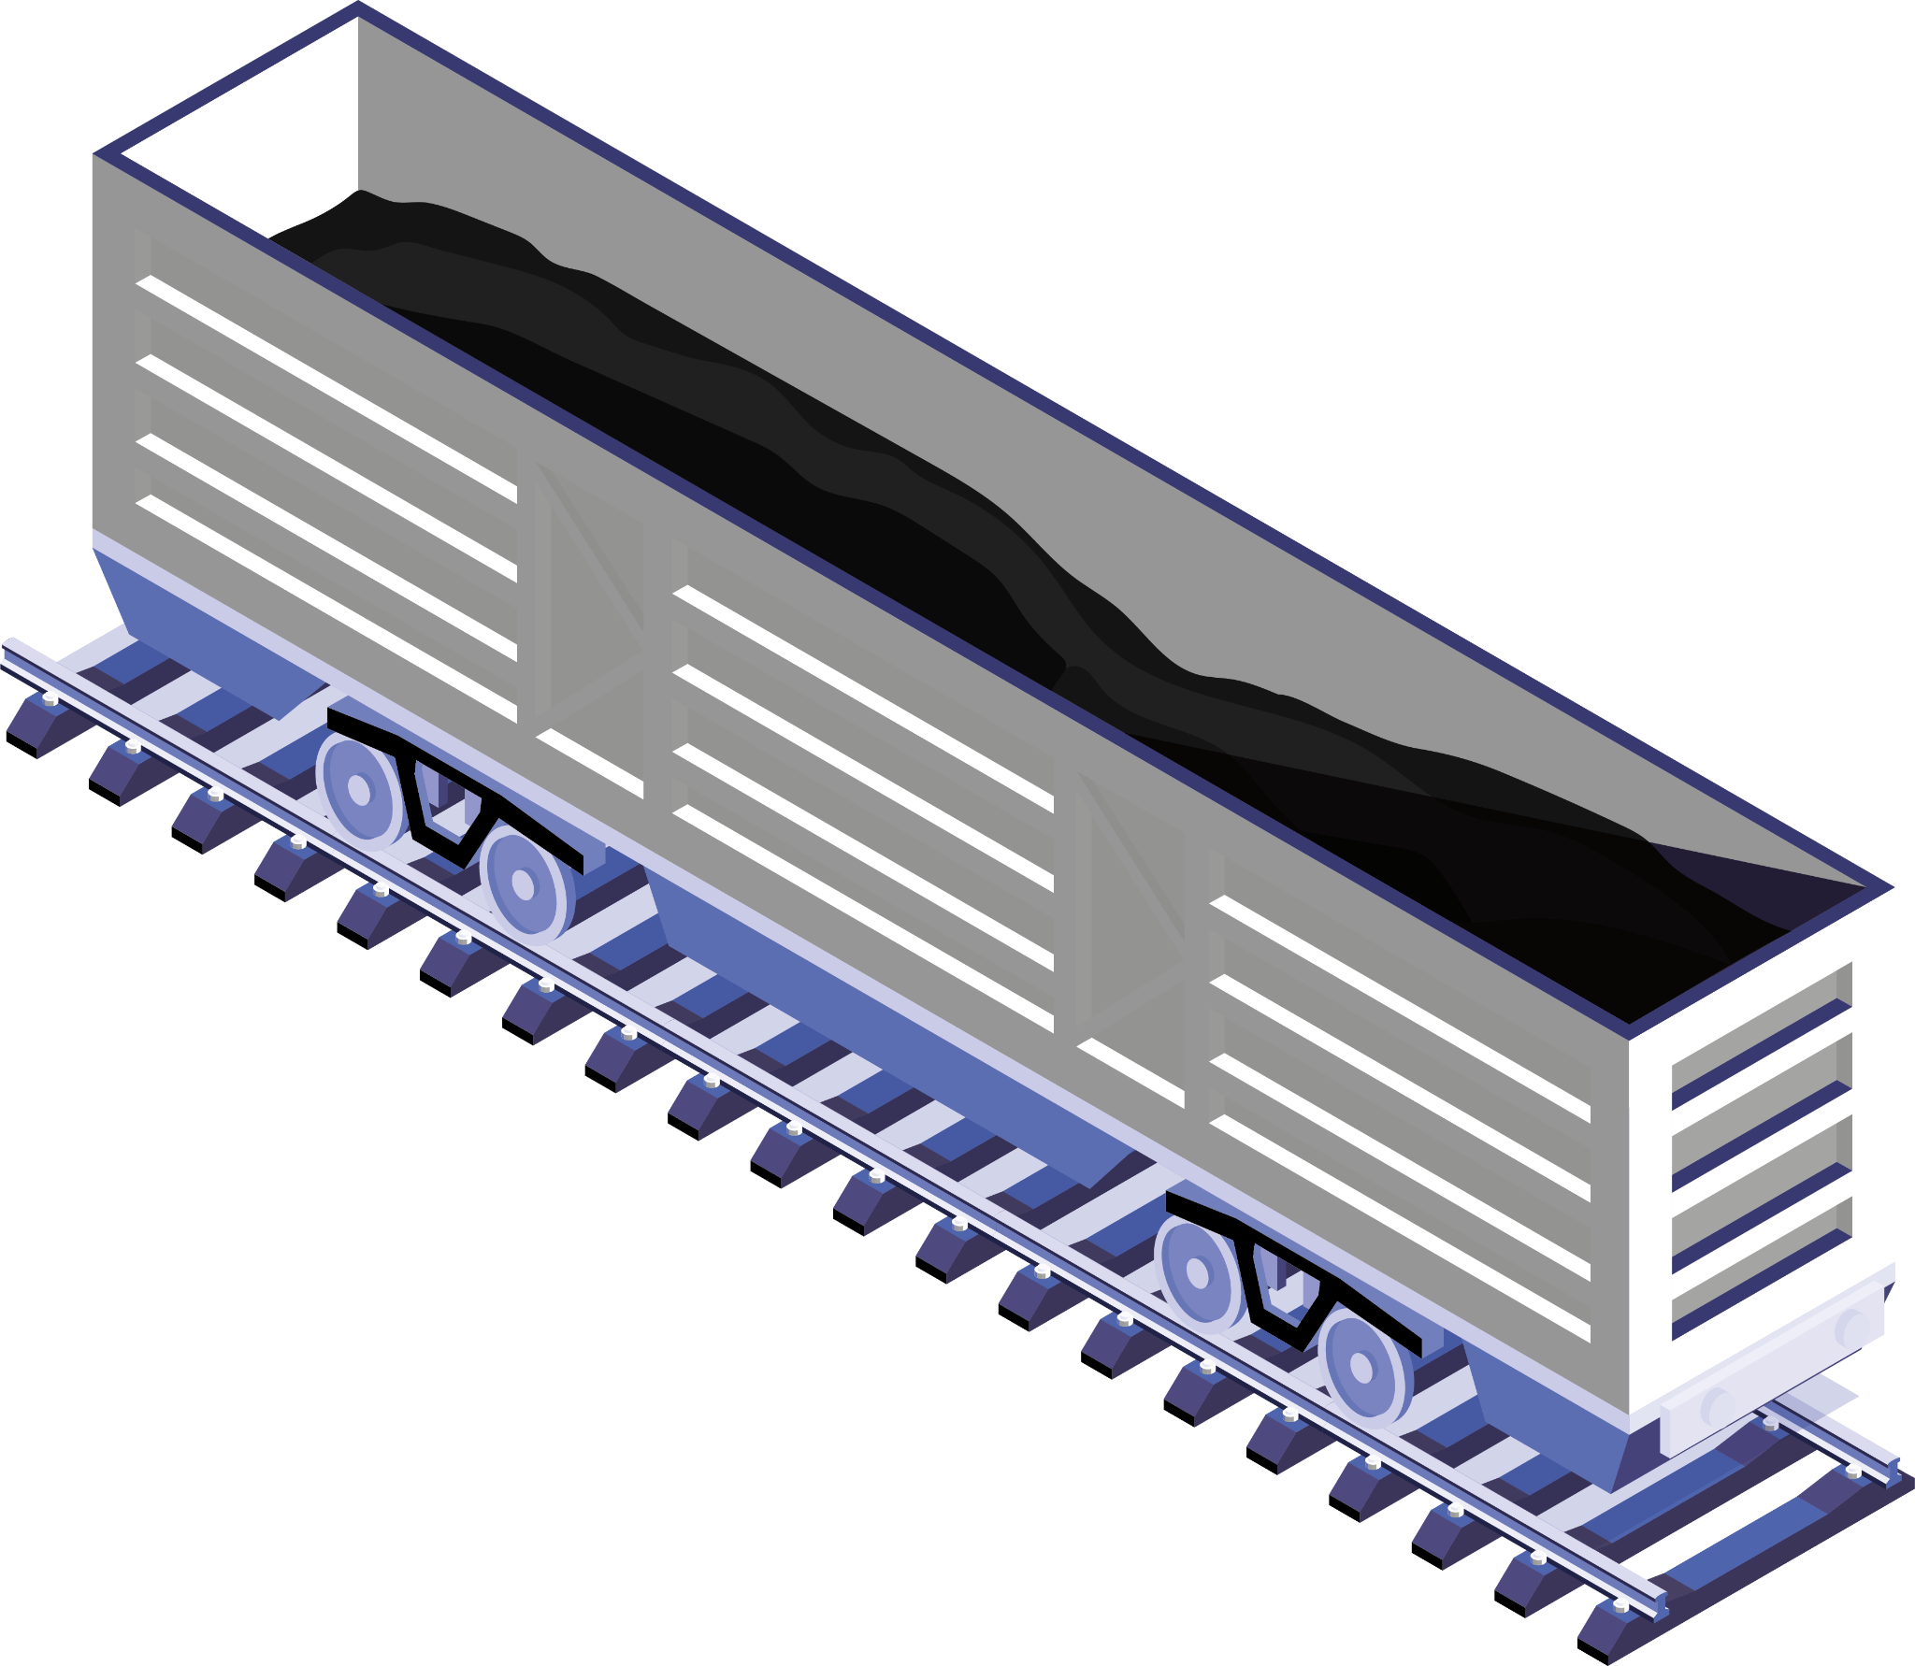
Future Scop
1
Contactless Ticketing
AI-Driven Chatbots
2
3
Augmented Reality (AR) Navigation
Biometric Authentication
4

Slide 10
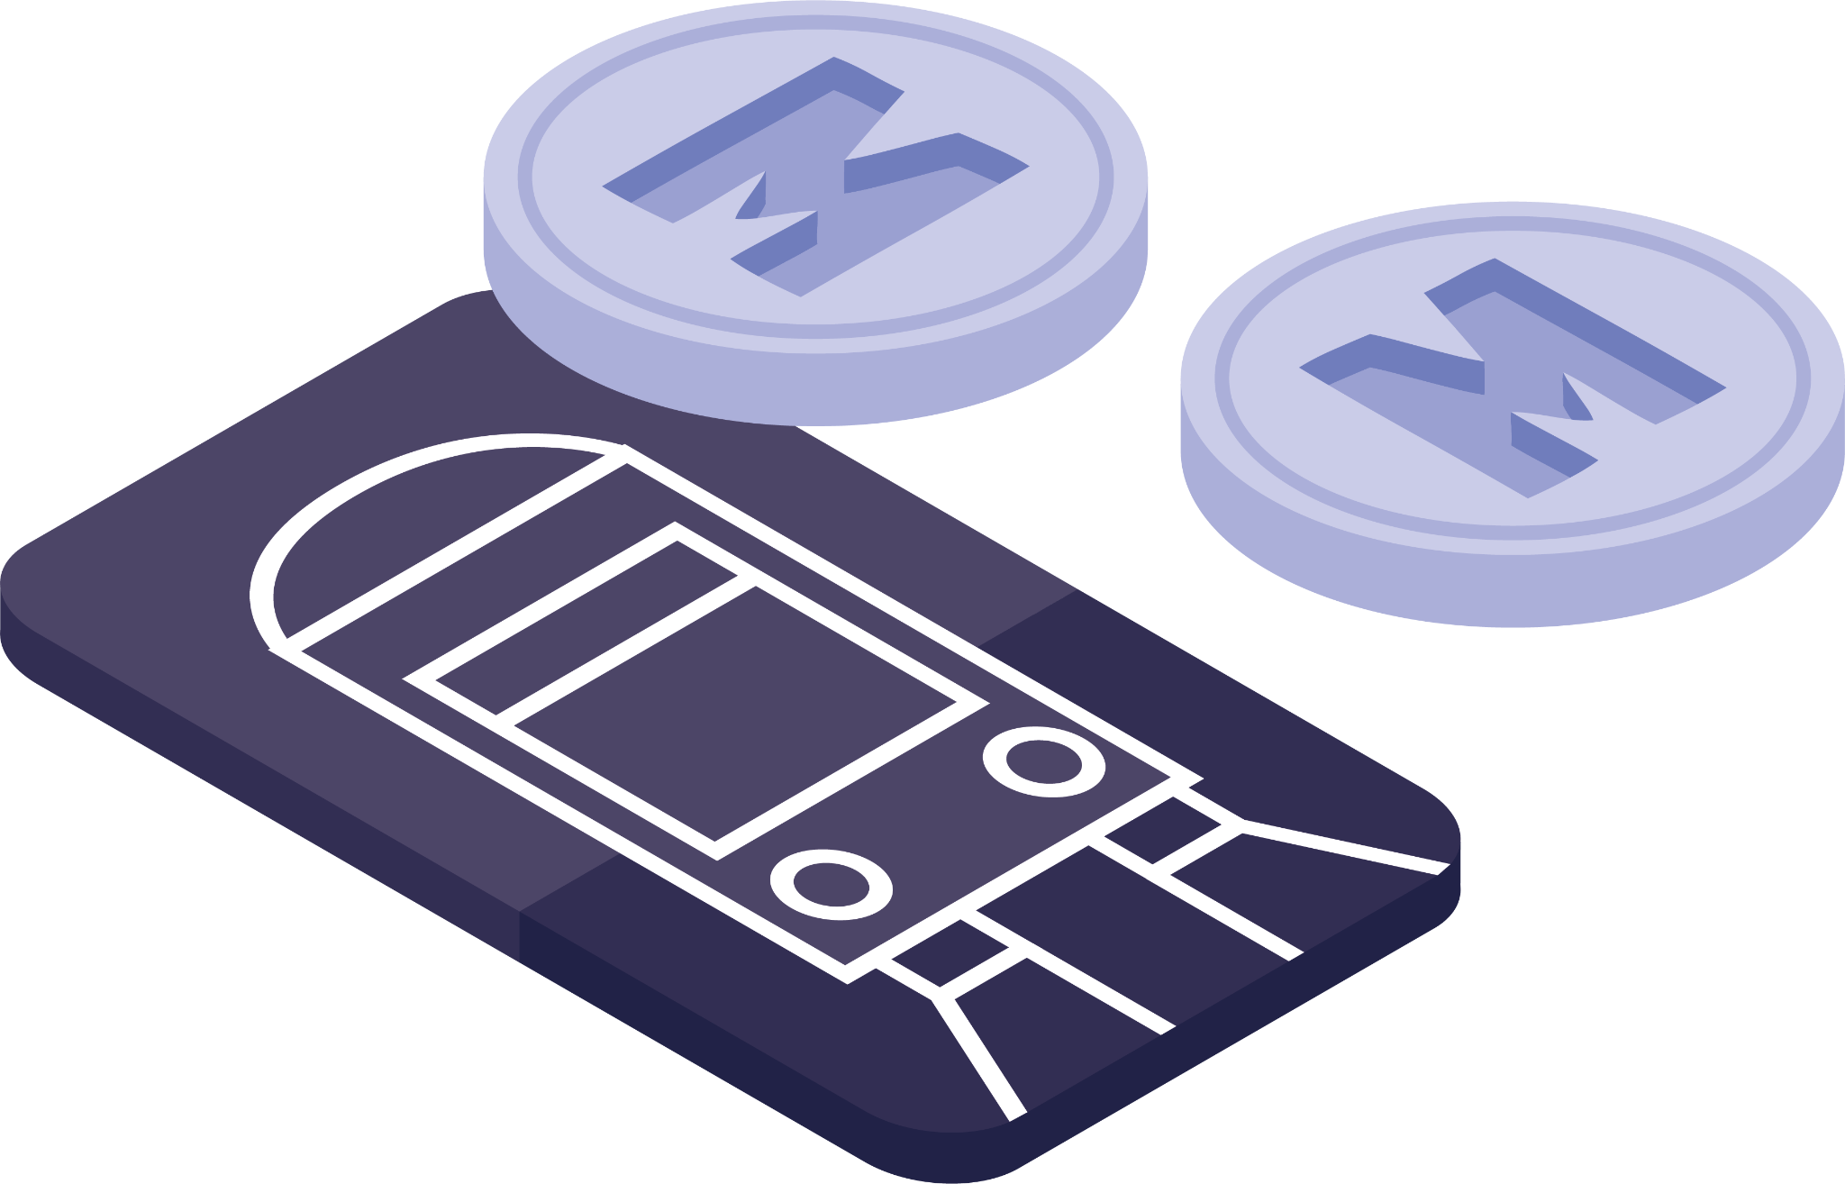
Conclusion
…..Write

Slide 11
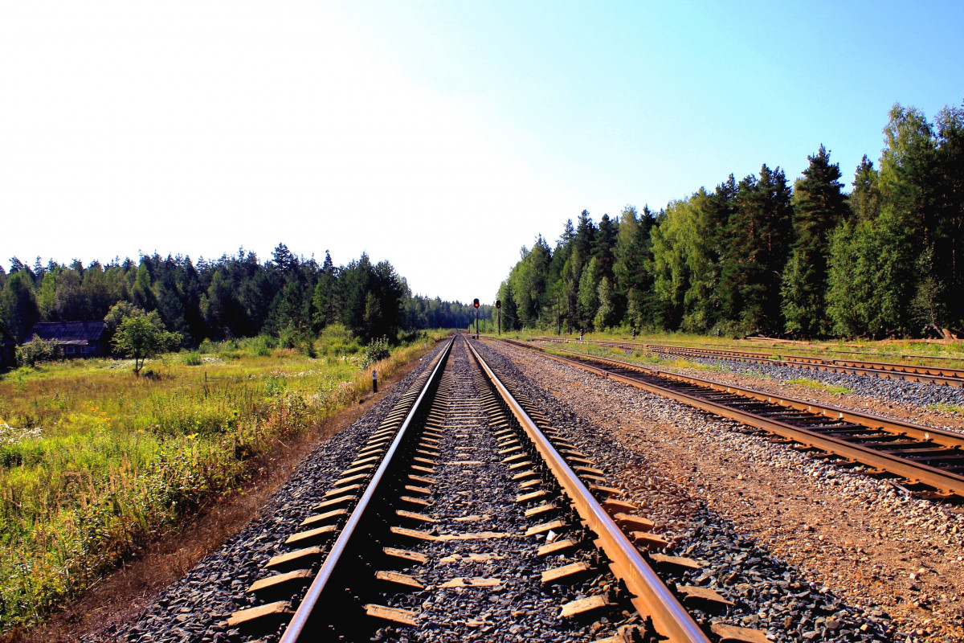
Thank You

